Slide 1
Programming the Crowd

Slide 2
Algorithms for human computation
MTurk provides an on-demand source for human computation
Potential opportunities for exploring algorithms that use people as a function call
However, MTurk isn’t set up to support algorithms

Slide 3
MTurk limitations
MTurk requesters can post batches of independent jobs
Perfect for tasks that can be done in parallel like labeling 1000 images
But poorly suited for tasks that build on each other
What is MTurk missing that is essential in algorithms or programming languages?
Notes:
if then else example, for loops, while loops

Slide 4
TurKit: A programming language for the crowd
ideas = []
for (var i = 0; i < 5; i++) {
idea = mturk.prompt(
"What’s fun to see in New York City? Ideas so far: " + ideas.join(", "))
ideas.push(idea)
}
ideas.sort(function (a, b) {
v = mturk.vote("Which is better?", [a, b]) return v == a ? ‐1 : 1
})
Notes:
Generate a list of ideas on what to do in NYC and then sort them.
TurKit lets them use Mechanical Turk as a function call to generate ideas and compare them.

Slide 5
What new concerns exist for crowd programming?
After a HIT is posted to MTurk, it can take hours before Turkers complete it and so latency could cause algorithms to take days
What is the behavior if your program crashes?
What if this happens after you have already spent money on a bunch of HITs?

Slide 6
Crash and re-run
TurKit introduces a new programming paradigm called crash and rerun
Designed for long running processes where local computation is cheap, and remote work is costly
(Crash) Cache and re-run
Notes:
Page 46 of Greg’s thesis gives some examples of other programming languages which maintain states between runs

Slide 7
Quicksort
quicksort(A):
if A.length > 0:
pivot ← A.remove(A.randomIndex())
left ← new array; right ← new array
for x in A:
if compare(x, pivot):
left.add(x)
else:
right.add(x)
quicksort(left)
quicksort(right)
A.set(left + pivot + right)

Slide 8
81
39
68
9
3
28
62
42
25
97
Notes:
animation of quicksort
animate it once for an array of words, animate it a second time for an array of kittens
http://www.csanimated.com/animation.php?t=Quicksort
NOTE: The above link is deprecated as Adobe Flash is no longer supported; alternatively, here is another animation of Quicksort: http://cs.armstrong.edu/liang/animation/web/QuickSortPartition.html

Slide 9
81
39
68
9
3
28
62
42
25
97

Slide 10
81
39
68
9
3
28
62
25
97
42

Slide 11
39
68
9
3
28
62
25
97
81
>
42

Slide 12
39
68
9
3
28
62
25
97
42
81

Slide 13
68
9
3
28
62
25
97
39
<
42
81

Slide 14
68
9
3
28
62
25
97
42
39
81

Slide 15
9
3
28
62
25
97
68
>
42
39
81

Slide 16
9
3
28
62
25
97
42
39
81
68

Slide 17
3
28
62
25
97
9
<
42
39
81
68

Slide 18
3
28
62
25
97
42
39
9
81
68

Slide 19
28
62
25
97
3
<
42
39
9
81
68

Slide 20
62
25
97
28
<
42
39
9
3
81
68

Slide 21
25
97
62
>
42
39
9
3
28
81
68

Slide 22
97
25
<
42
39
9
3
28
81
68
62

Slide 23
97
>
42
39
9
3
28
25
81
68
62

Slide 24
42
39
9
3
28
25
81
68
62
97

Slide 25
39
9
3
28
25
42
81
68
62
97

Slide 26
39
9
3
28
25
42
81
68
62
97

Slide 27
39
9
3
25
42
81
62
97
28
68

Slide 28
9
3
25
42
62
97
39
81
>
>
28
68

Slide 29
3
25
42
97
9
62
<
<
28
68
39
81

Slide 30
25
42
3
97
<
>
28
68
9
39
62
81

Slide 31
42
25
<
28
68
9
3
39
62
81
97

Slide 32
42
28
68
9
3
25
39
62
81
97

Slide 33
9
3
25
28
39
42
62
68
81
97

Slide 34
9
3
25
28
39
42
62
68
81
97

Slide 35
9
3
25
28
39
42
62
68
81
97

Slide 36
3
25
28
39
42
62
68
97
9
81

Slide 37
25
28
39
42
62
68
3
97
<
>
9
81

Slide 38
25
28
39
42
62
68
9
81
3
97

Slide 39
28
39
42
62
68
25
>
9
81
3
97

Slide 40
28
39
42
62
68
9
81
3
25
97

Slide 41
3
9
25
28
39
42
62
68
81
97

Slide 42
3
9
25
28
39
42
62
68
81
97

Slide 43
Quicksort on MTurk
compare(a, b):
hitId ← createHIT(...a...b...)
result ← getHITResult(hitId)
return (result says a < b)

Slide 44
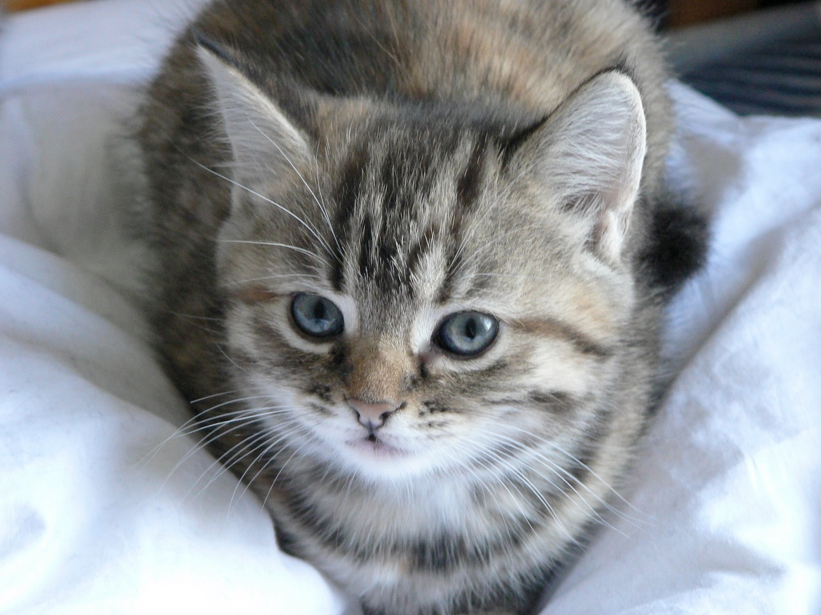




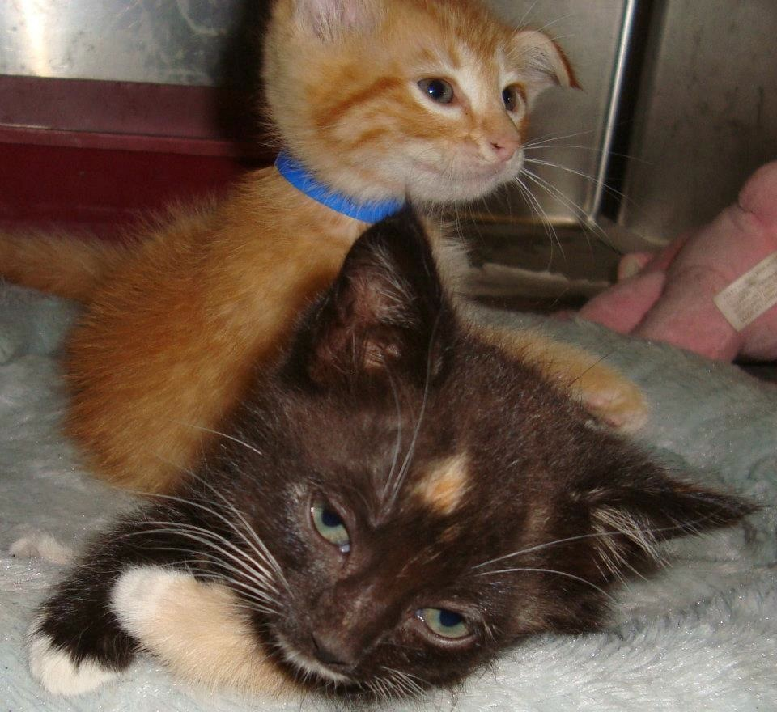


Slide 46
>

Slide 47
>

Slide 48
<

Slide 49
<

Slide 50
>

Slide 51
>

Slide 55
>
<

Slide 56
>

Slide 57
<

Slide 61
>

Slide 63
Quicksort as a long-running process
With this implementation we must wait for people to complete their judgments
The algorithm may need to run for a very long time while waiting
Challenge: How to maintain state

Slide 64
Quicksort as a long-running process
Normally quicksort maintains its state in the heap or the stack
These are normally dynamically allocated in memory, and used by all of the programs running on a computer
Memory isn’t typically used for hours or days
If the computer reboots, then our program’s state would be lost and we would lose $$$

Slide 65
Store results in a DB
Insight of crash-and-rerun paradigm is that if the program crashes, it should be cheap to re-run
Use a database to store all of the results up to the place that it crashed
Since local computation is cheap, calling DB and re-executing code with store results is cheap

Slide 66
New keyword once
Costly operations can be marked in a TurKit program with keyword once
once denotes that an operation should only be executed once across all runs of a program

Slide 67
Quicksort on MTurk
compare(a, b):
hitId ← once createHIT(...a...b...)
result ← once getHITResult(hitId)
return (result says a < b)
Subsequent runs of the program will check the database before performing these operations

Slide 68
When should you mark a function with once?
High cost: This is its main usage; whenever a function is high-cost in terms of money or time, once saves the day
Non-determinism: Storing results in DB assumes that the program executes in a deterministic way

Slide 70
Notes:
Originally we picked this picture at random to begin the comparison.

Slide 71
Notes:
But what if we next time, we instead randomly chose this one?

Slide 72
✓

Slide 73
✓
X
X
X
✓
X

Slide 74
X
X
X
✓
X
✓
X

Slide 75
Quicksort
quicksort(A):
if A.length > 0:
pivot ← A.remove(once A.randomIndex())
left ← new array; right ← new array
for x in A:
if compare(x, pivot):
left.add(x)
else:
right.add(x)
quicksort(left)
quicksort(right)
A.set(left + pivot + right)

Slide 76
When should you mark a function with once?
Side-effects: If a function has side effects during repeated calls, then wrap it in once
Notes:
For example, calling “Bonus” on MTurk multiple times would caused problems, or if calling Reject toggled the operation, then wrap with once.

Slide 77
Other benefits of once
Incremental programming: You can write part of an algorithm, test it, view the results, modify it, and rerun.
Retroactive print-line debugging: If your program behaves in an unexpected fashion, you can put in debugging print statements after the fact
This also lets you print data to a file if you decide that you want to analyze it
Notes:
As long as you haven’t modified the order of important operations, then once will save you money with incremental programming
Retroactive print-line debugging will execute quickly, because of the cached results

Slide 78
TurKit script
TurKit is built on top of JavaScript
Users have full access to JavaScript
Plus a set of APIs built around MTurk and the crash-and-rerun programming paradigm

Slide 79
TurKit keywords
once
crash
fork / join

Slide 80
The crash keyword
Why in the hell would you want to tell your program to crash?
Since we cache results in a DB, crash is an alternate to wait
Most common use for crash is waiting for results to be returned from MTurk
TurKit automatically re-runs program after a set interval

Slide 81
fork allows for parallel execution
TurKit allows multiple branches to be run in parallel via fork
Calling crash from within a forked branch resumes the execution of the former branch
This allows you to post multiple jobs on MTurk simultaneously
The script can make progress on whatever path gets a result first

Slide 82
One HIT at a time
a = createHITAndWait() // HIT A
b = createHITAndWait(...a...) // HIT B
c = createHITAndWait() // HIT C
d = createHITAndWait(...c...) // HIT D
B depends on A
D depends on C
They don’t depend on each other. Why wait?

Slide 83
Multiple HITs at a time
fork(function() {
a = createHITAndWait() // HIT A
b = createHITAndWait(...a...) // HIT B
})
fork(function() {
c = createHITAndWait() // HIT C
d = createHITAndWait(...c...) // HIT D
})
Notes:
The first time around, TurKit would get to the first fork, create HIT A, and try to wait for it.
It would not be done, so it would crash that forked branch (rather than actually waiting),
And then the next fork would create HIT C.
So the first time the script runs, HITs A and C will be created, and each subsequent time it runs, it will check on both HITs to see if they are done.

Slide 84
The join keyword
fork(...b = ...)
fork(...d = ...)
join()
e = createHITAndWait(...b...d...)
join waits for all previous forks for finish

Slide 85
Calling Mechanical Turk
TurKit adds several simple commands for interacting with MTurk:
prompt
vote
sort

Slide 86
Calling MTurk: prompt
print(mturk.prompt(“When did Colorado become a state?”))
prompt optionally allows a second argument with the number of responses
a = mturk.prompt(“What is your favorite color?”, 100)

Slide 87
Calling MTurk: vote
v = mturk.vote("Which is better?", [a, b])
// returns the list item with the most votes
Optional 3rd argument to specify how many votes to collect

Slide 88
Calling MTurk: vote
function vote(message, options) {
// create comparison HIT
var h = mturk.createHITAndWait({
...message...options...
assignments : 3})
// get enough votes
while (...votes for best option < 3...) {
mturk.extendHIT(...add assignment...)
h = mturk.waitForHIT(h)
}
return ...best option...
}
Notes:
More sophisticated voting that doesn’t collect all votes if first ones are for majority.

Slide 89
Calling MTurk: sort
ideas.sort(function (a, b) {
v = mturk.vote("Which is better?", [a, b])
return v == a ? ‐1 : 1
})
This version just uses JavaScript’s built-in sorting function
Defines a comparator using mturk.vote
Negative: Comparisons are done serially
Notes:
The paper on the syllabus defines a way of doing quick sort in parallel using the fork() command

Slide 90
Under the hood
TurKit is handles the MTurk API
It generates web pages and CSS and hosts them on Amazon’s S3 server
Nice additional features, like disabling of form elements while in preview mode
DB is serialized using JSON

Slide 91
TurKit
IDE for writing TurKit scripts, running them, and automatically rerunning them
TurKit “crashes” after publishing a HIT; re-running polls MTurk to check for result
Provides controls for switching from sandbox into normal MTurk, clearing DB

Slide 92
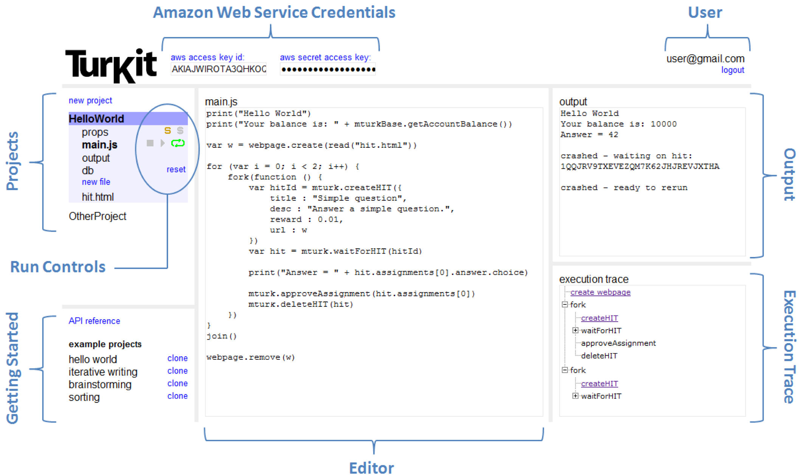
Notes:
ccb - todo - update this with screenshots

Slide 93
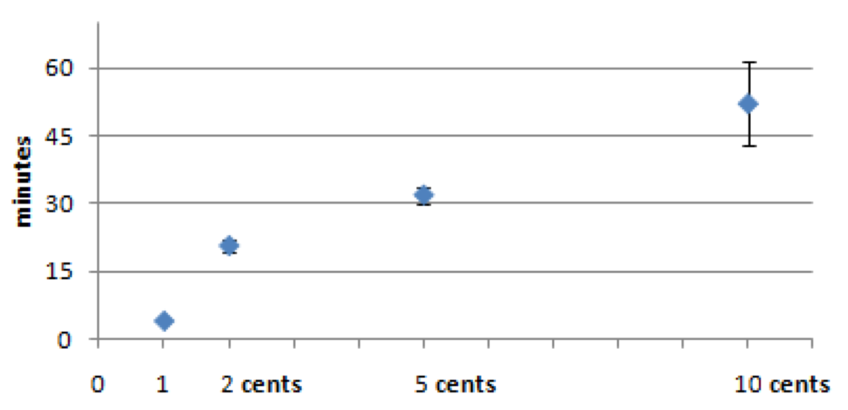
Time for results to come back, by reward amount
Notes:
Analyzed results over 30,000 assignments. Time took longer for higher paying tasks. Why? Higher paying tasks might contain more work, and therefore are longer. Even subtracting work time out, the time until take-up followed the same trend. Why?
Our higher paying tasks are typically more difficult, so we expect them to take longer to perform. However, if we subtract this time, the chart still increases, meaning it takes longer for turkers to start the higher paying tasks. One explanation is that turkers sort by reward, and 10-cent tasks are not on the first page of results. Another explanation is that turkers are looking for quick and easy tasks.

Slide 94
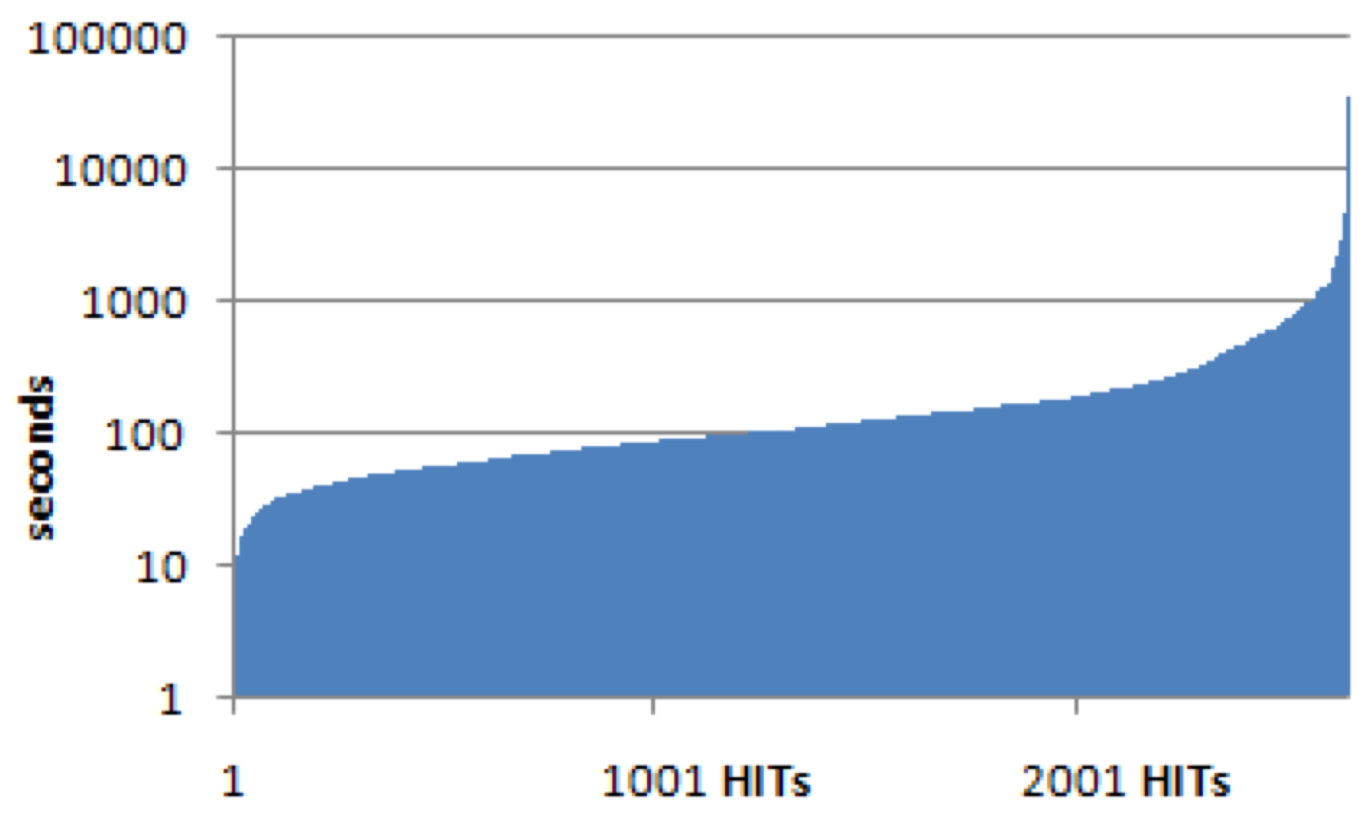
Time for first $0.01 assignment to complete
Notes:
Graph based on 2648 HITs with 1 cent reward. Only five completed within 10 seconds.
This gives a better picture of the round-trip time-to-completion for the 1-cent tasks. The average is 4 minutes, where 82% take between 30 seconds and 5 minutes. About 0.1% complete within 10 seconds. The fastest is 7 seconds.
Note log scale on y axis

Slide 95

Dealing with latency
Build the programming language to deal with high-latency operations
Do something to optimize throughput on MTurk
One (nefarious) example: Artificially inflate number of assignments in your HIT to get front-page placement
Notes:
ccb - todo - summarize Greg’s paper on SEO for MTurk

Slide 96
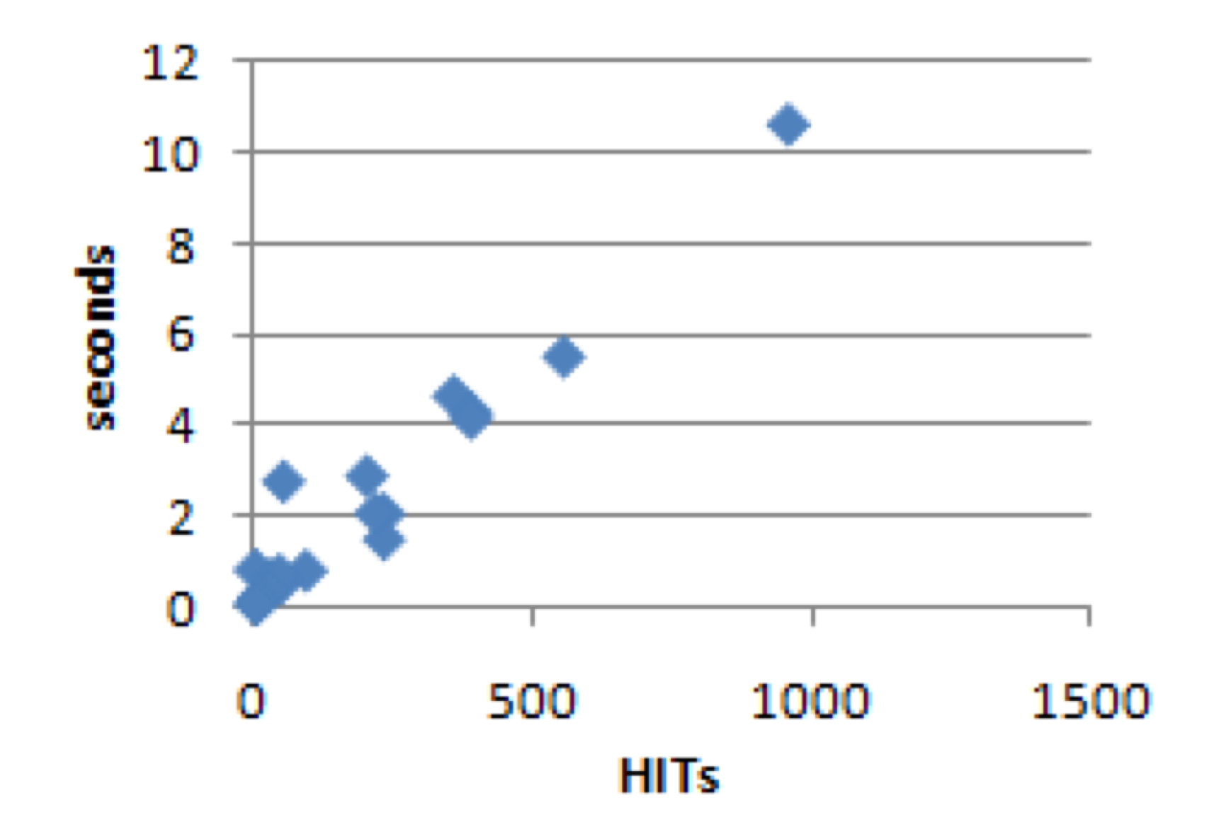
Time to execute once all HITs have been cached
Notes:
The largest script in our corpus creates 956 HITs. It takes 10.6 seconds to rerun a full trace, and the database file is 7.1MBs. It takes Rhino 0.91 seconds to parse and load the database into memory, where the database expands to 25.8MBs.

Slide 97
Pros and cons of TurKit
Con: Scalability – assumes local computation is minimal. Rerunning after each HIT might be tedious if task is large
Con: Parallel programming – not completely general in TurKit. once, fork and join do not give enough state.
Con: Experimental replicability – usually one downside of human computation is that results with differ each time. Not so with TurKit!
Notes:
Parallel programming in the crash-and-rerun model is not completely general. For instance, we proposed a parallel version of quicksort that performs the partition in parallel, and then sorts each sublist in parallel. However, it joins between partitioning the elements, and sorting the sublists. In theory, this is not necessary. Once we have a few elements for a given sublist, we should be able to start sorting it right away (provided that we chose a pivot from among the elements that we have so far). Doing so is possible in TurKit by storing extra state information in the database, but is infeasible using once, fork and join alone.

Slide 98
What experiments would you run?

Slide 99
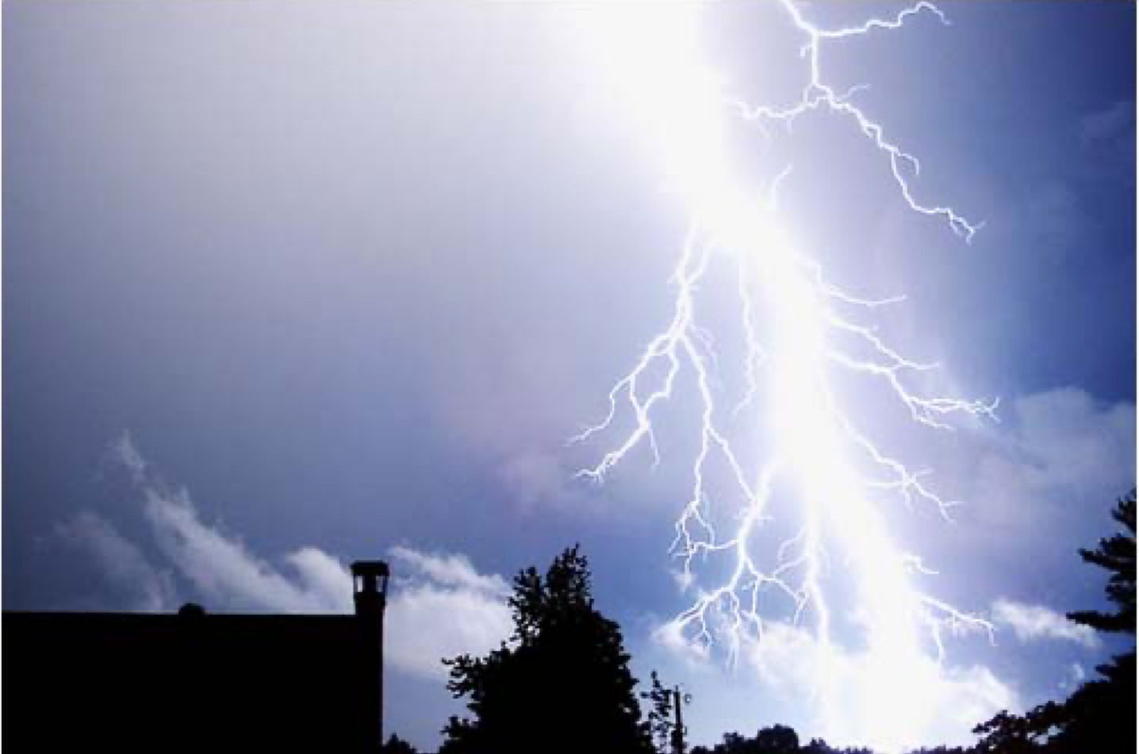
Next time…
Please describe the text factually
(You may use the provided text as a starting point, or delete it and start over)
Use no more than 500 characters
Lightening strike in a blue sky near a tree and a building.

